Slide 1
AVL Trees Georgy Adelson-Velsky and Landis' tree

Slide 2
Balanced and unbalanced BST
1
4
2
2
5
3
1
3
4
4
Is this “balanced”?
5
2
6
6
1
3
5
7
7

Slide 3
Perfect Balance
Want a (almost) complete tree after every operation
tree is full except possibly in the lower right
This is expensive
For example, insert 2 in the tree on the left and then rebuild as a complete tree
6
5
Insert 2 &
complete tree
4
9
2
8
1
5
8
1
4
6
9

Slide 4
AVL - Good but not Perfect Balance
AVL trees are height-balanced binary search trees
An AVL tree has balance factor calculated at every node
For every node, heights of left and right subtree can differ by no more than 1

Slide 5
AVL Trees
5
7
2
8
2
8
1
4
7
1
4
3
3
5
An AVL Tree
Not an AVL Tree

Slide 6
AVL Trees
The height of the left subtree minus the height of the right subtree of a node is called the balance of the node. For an AVL tree, the balances of the nodes are always -1, 0 or 1.
The height of an empty tree is defined to be -1.

Slide 7
Node Height and Balance Factor
height of node = h
balance factor = h_{left} - h_{right}
empty height = -1
Tree A (AVL)
Tree B (AVL)
6
height=2 BF=1-0=1
6
1
0
4
9
4
9
0
0
1
5
-1
-1
1
5
8
-1
-1
-1
-1
-1
-1
-1
-1
-1
-1
-1

Slide 8
AVL Trees
Given an AVL tree, if insertions or deletions are performed, the AVL tree may not remain height balanced.

Slide 9
Node Heights after Insert 7
Tree A (AVL)
Tree B (not AVL)
3
balance factor
1-(-1) = 2
6
6
2
4
9
4
9
1
-1
1
5
7
1
5
8
0
7
height of node = h
balance factor = h_{left}-h_{right}
empty height = -1

Slide 10
AVL Trees
To maintain the height balanced property of the AVL tree after insertion or deletion, it is necessary to perform a transformation on the tree so that
1) the in-order traversal of the transformed tree is the same as for the original tree (i.e., the new tree remains a binary search tree).
2) the tree after transformation is height balanced.

Slide 11
Insert and Rotation in AVL Trees
Insert operation may cause balance factor to become 2 or –2 for some node
only nodes on the path from insertion point to root node have possibly changed in height
Follow the path up to the root, find the first node (i.e., deepest) whose new balance violates the AVL condition. Call this node a
If a’s new balance factor (the difference h_{left}-h_{right}) is 2 or –2, adjust tree by rotation around the node

Slide 12
Single Rotation in an AVL Tree
2
2
6
6
1
2
1
1
4
9
4
8
0
0
1
0
0
0
0
1
5
8
1
5
7
9
0
7

Slide 13
Right Rotation (RR) in an AVL Tree
a
b
b becomes the new root.
a takes ownership of b's right child, as its left child, or in this case, null.
b takes ownership of a, as it's right child.
b
c
a
c

Slide 14
Left Rotation (LL) in an AVL Tree
a
b
b becomes the new root.
a takes ownership of b's left child as its right child, or in this case, null.
b takes ownership of a as its left child.
b
a
c
c

Slide 15
Single Rotation may be Insufficient
a
c
a
Left
Right
c
c
a
b
b
b
c becomes the new root.
a takes ownership of c's left child as its right child, in this case, b.
c takes ownership of a as its left child.
a becomes the new root.
c takes ownership of a's right child as its left child, b.
a takes ownership of c as its right child.

Slide 16
Left-Right Rotation (LR) or "Double left"
a
a
b
Left
c
b
a
c
Right
b
c
perform a right rotation on the right subtree.
b becomes the new root.
a takes ownership of b's left child as its right child, in this case null.
b takes ownership of a as its left child.

Slide 17
Right-Left Rotation (RL) or "Double right"
c
c
b
Right
a
b
Left
a
c
b
a
perform a left rotation on the left subtree.
b becomes the new root.
c takes ownership of b's right child as its left child, in this case null.
b takes ownership of c as its right child.

Slide 18
Insert and Rotation in AVL Trees
Insert operation may cause balance factor to become 2 or –2 for some node
only nodes on the path from insertion point to root node have possibly changed in height
Follow the path up to the root, find the first node (i.e., deepest) whose new balance violates the AVL condition. Call this node a
If a new balance factor (the difference h_{left}-h_{right}) is 2 or –2, adjust tree by rotation around the node

Slide 19
How and when to rotate?
Let the node that needs rebalancing be a.
In general, violation may occur for following 4 cases:
Outside Cases (require single rotation) :
1. Insertion into left subtree of left child of a (RR).
2. Insertion into right subtree of right child of a (LL).
Inside Cases (require double rotation) :
3. Insertion into right subtree of left child of a (RL).
4. Insertion into left subtree of right child of a (LR).

Slide 20
How and when to rotate?
IF tree is right heavy
{
IF tree's right subtree is left heavy
{
Perform Double Left rotation
}
ELSE {
Perform Single Left rotation
}
}
…
…
ELSE IF tree is left heavy
{
IF tree's left subtree is right heavy
{
Perform Double Right rotation
}
ELSE {
Perform Single Right rotation
}
}

Slide 21
Example: 3 2 1 4 5 6 7
construct binary search tree without height balanced restriction
depth of tree = 4

Slide 22
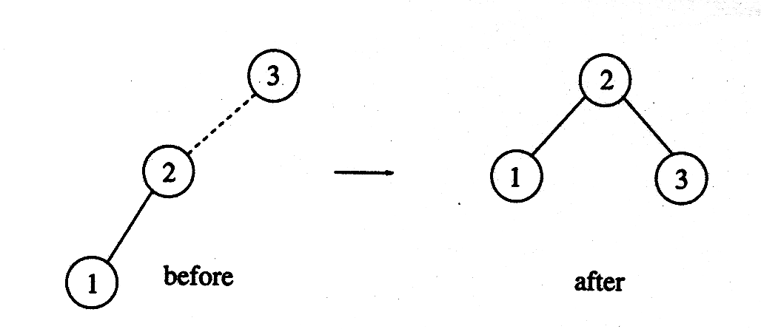
AVL Trees: Single Rotation
Construct AVL tree (height balanced)

Slide 23
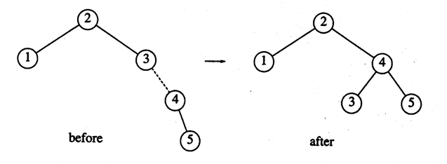
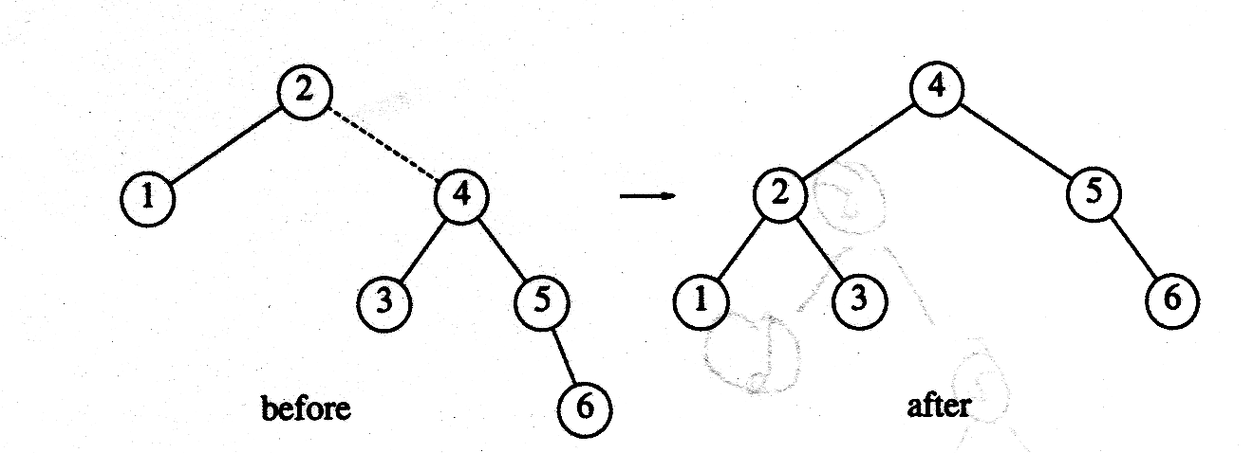
AVL Trees: Single Rotation
Insert 4, 5
Insert 6

Slide 24
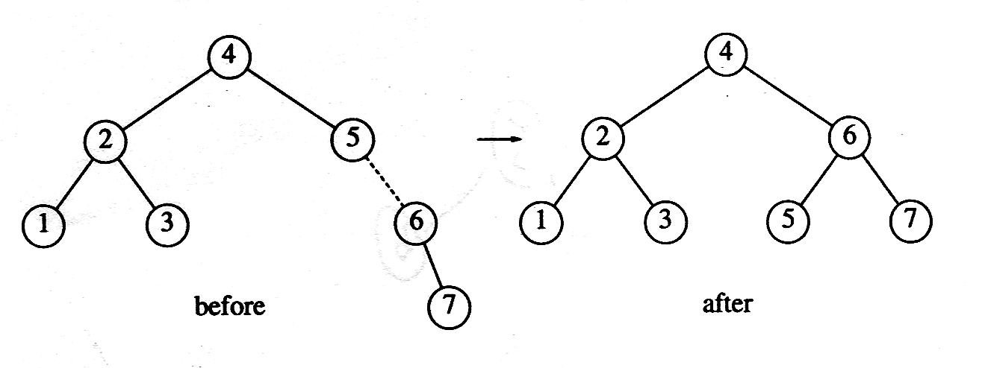
AVL Trees: Single Rotation
Insert 7

Slide 25
So far so good, what about inserting the following numbers
16, 15, 14, 13, 12, 11, 10, 8

Slide 26
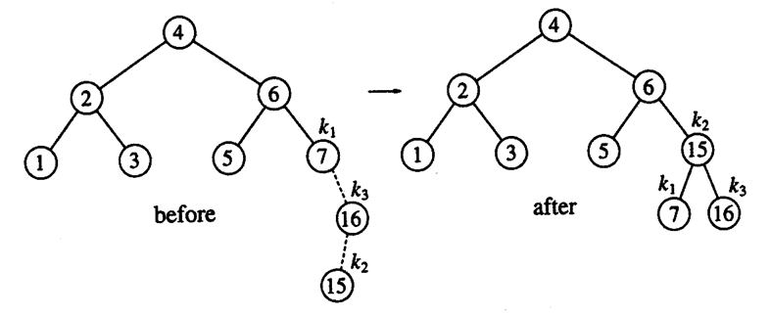
AVL Trees: Double Rotation
Example:

Slide 27
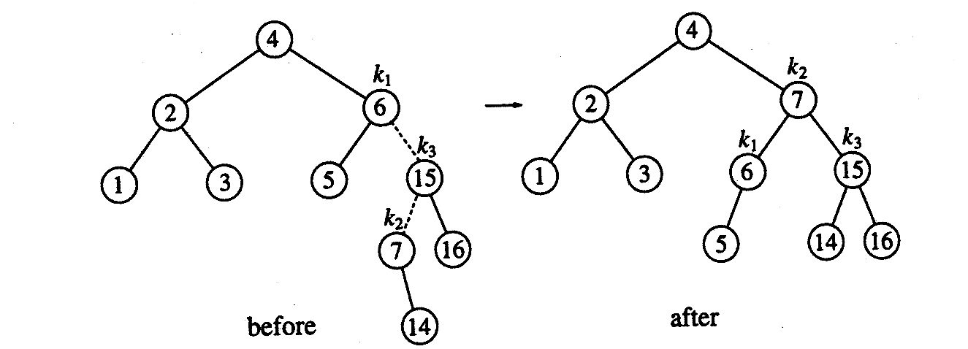
AVL Trees: Double Rotation
Insert 14

Slide 28
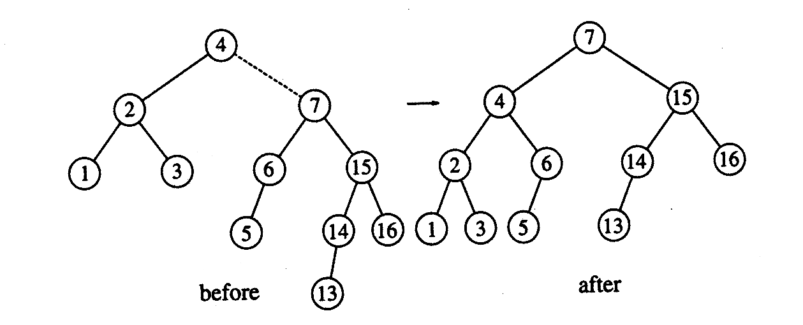
AVL Trees: Double Rotation
Insert 13 (This is single rotation: LL Case)

Slide 29
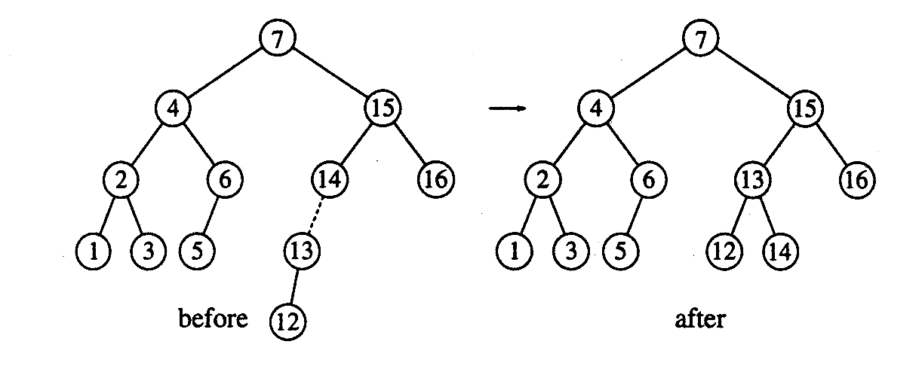
AVL Trees: Double Rotation
Insert 12

Slide 30
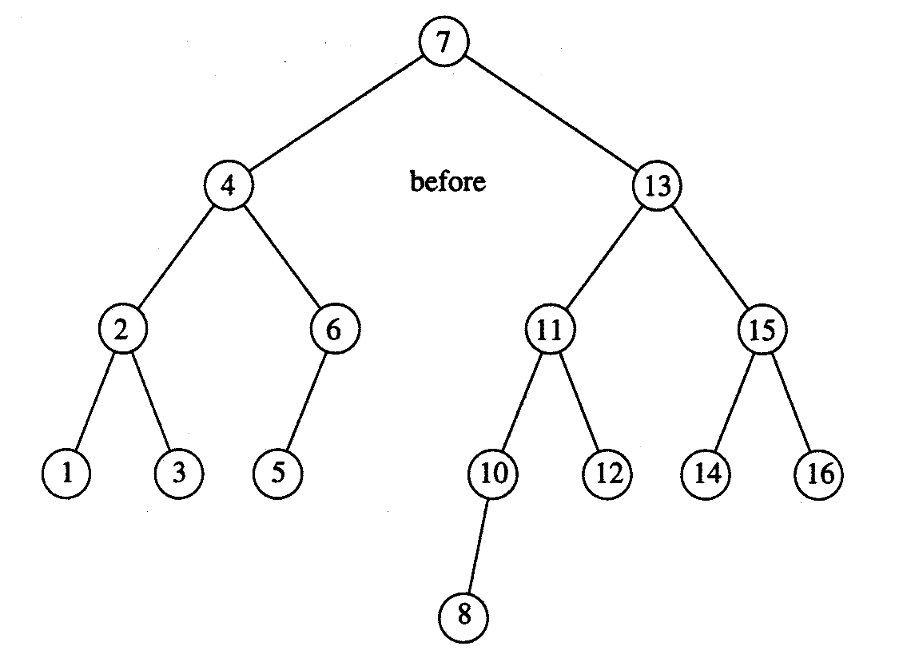
AVL Trees: Double Rotation
Insert 11 and 10 (single rotation), then 8

Slide 31
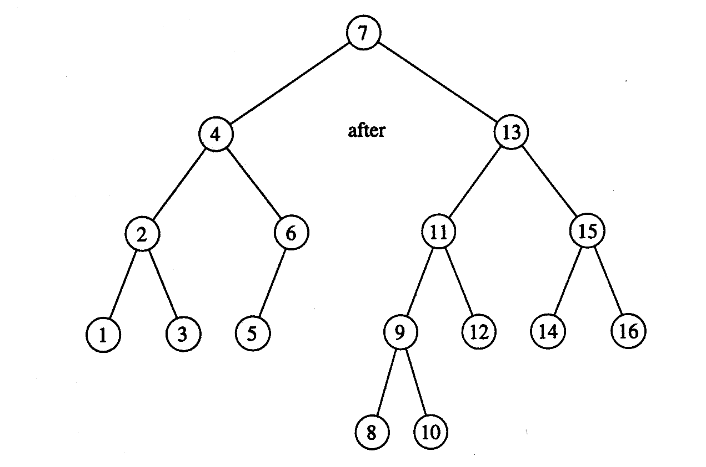
AVL Trees: Double Rotation
Inserting 9

